Slide 1
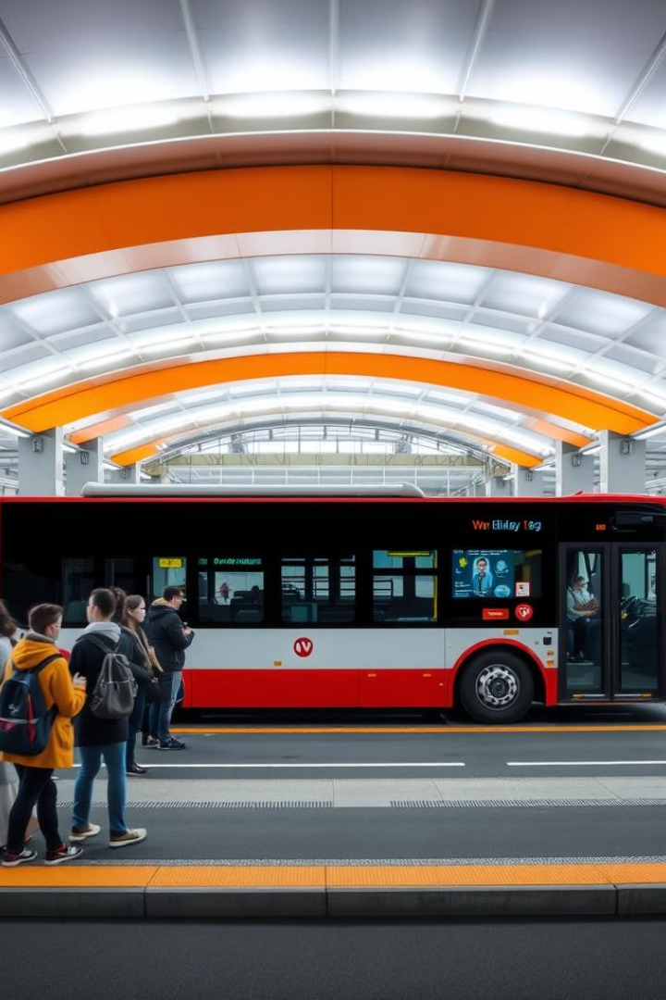
Bus Reservation Management System
This comprehensive Bus Reservation Management System provides an efficient solution for managing bus bookings, enforcing gender-based seating rules, and delivering a seamless user experience.
BY TOJIN ,JAIBY ,MAHALAKSHMI

Slide 2
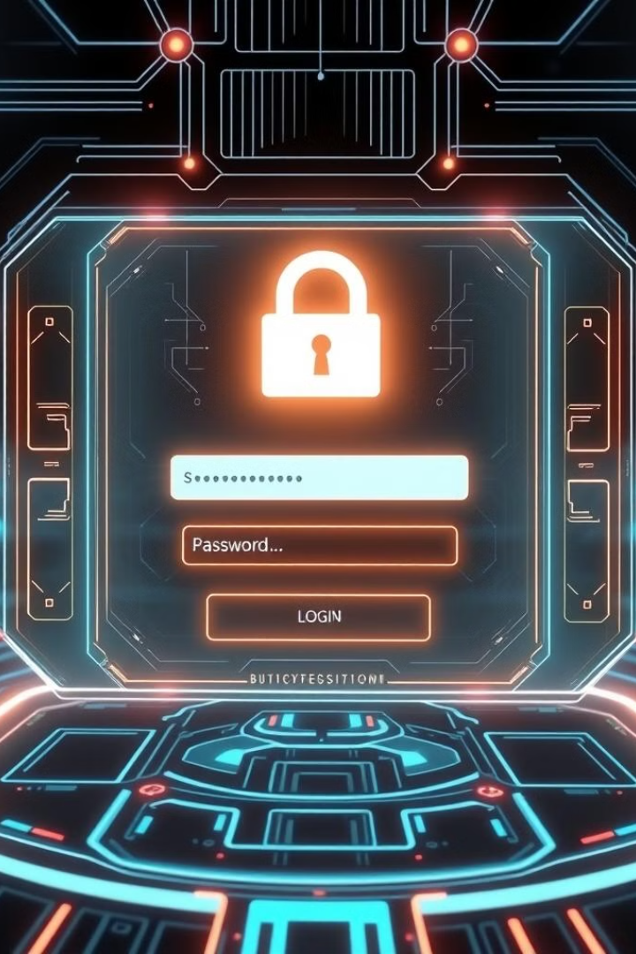
User Authentication
Login
Existing users can log in using their pre-registered credentials.
Registration
New users can create accounts by providing a unique username and password.
Secure Access
After successful login or registration, users are redirected to the main menu.

Slide 3
Main Menu Options
View Bus List
Book Tickets
Cancel Booking
Displays the list of available buses, including their names and respective routes.
Allows users to select a bus, specify the number of tickets, and choose available seats while enforcing gender-based seating rules.
Enables users to cancel their previously booked seats by entering the bus number and seat number.

Slide 4
Bus Information
Bus 1
1
Rukma Travels - Route 1: City Bangalore to City Thiruvalla
2
Bus 2
K-Swift - Route 2: City Bangalore to City Chennai
Bus 3
3
Airavat Express - Route 3: City Mumbai to City Goa
4
Bus 4
Yathra Travels - Route 4: City Goa to City Mangalore
Bus 5
5
SLS Travels - Route 5: City Mangalore to City Cochin
6
Bus 6
Maharaja Travels - Route 6: City Cochin to City Trivandrum

Slide 5
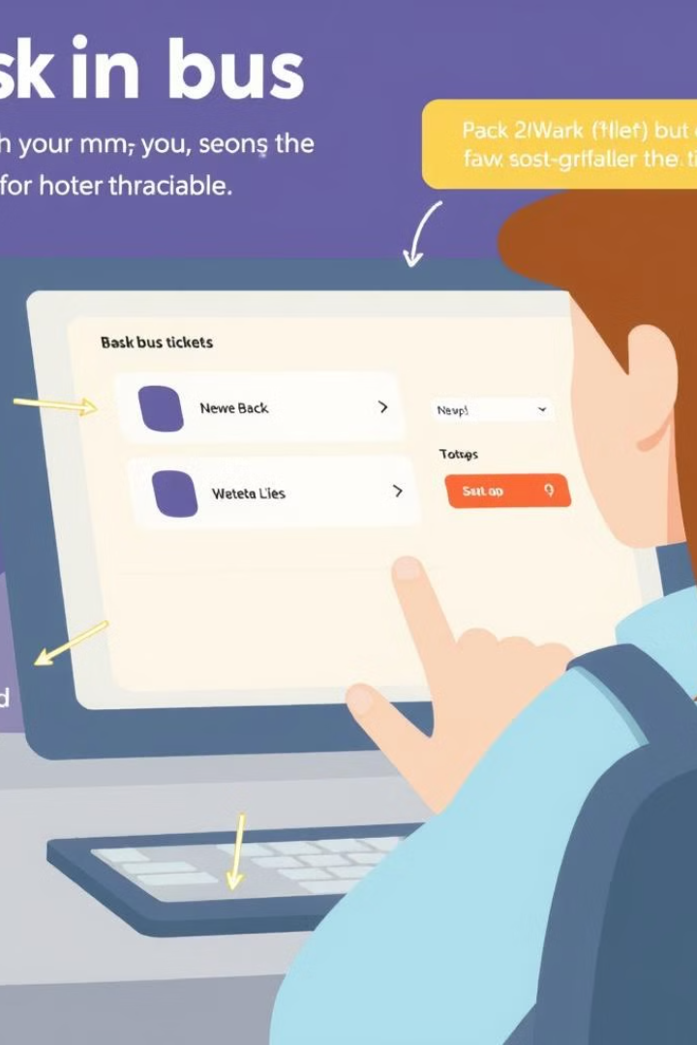




Booking Process
Select Bus
Users choose the bus they want to book tickets for.
Specify Tickets
Users enter the number of tickets they want to book.
Enter Gender
Users provide the gender of each passenger to enforce seating rules.
Choose Seats
The system displays available seats, and users select their desired seats.

Slide 6

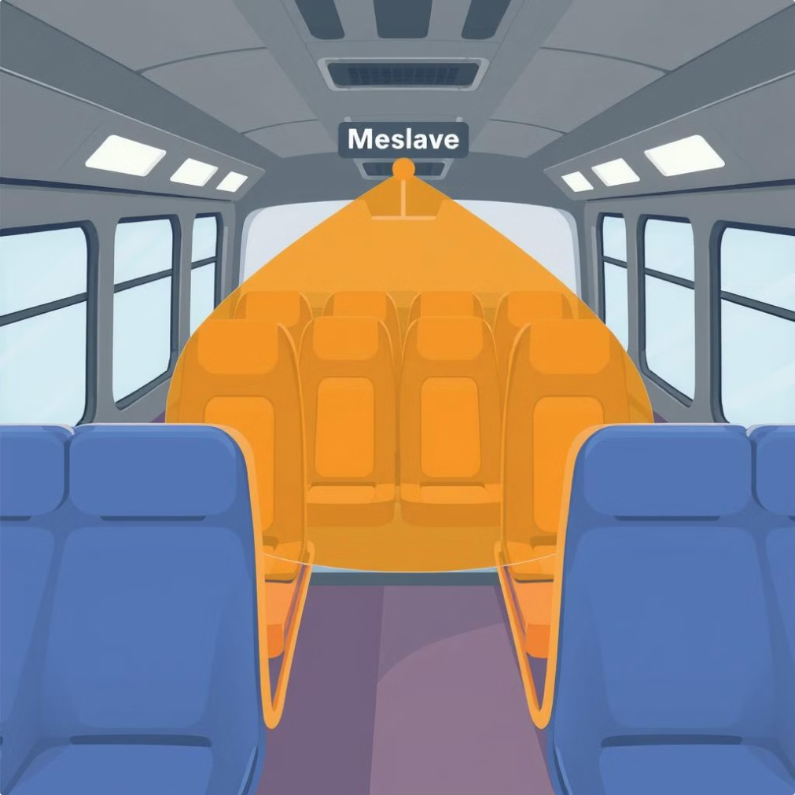



Seating Rules
Male Restriction
Male passengers cannot book seats next to female passengers unless both seats are empty.
Female-Booked Seats
Seats booked by female passengers are indicated and reserved for them.
Empty Seats
Available seats are marked as empty and can be booked by any passenger.

Slide 7




Cancellation Process
Specify Seat
Users enter the seat number they want to cancel.
Seat Verification
The system checks if the seat is already booked.
Cancellation
If the seat is booked, the cancellation is allowed, and the seat is marked as empty.

Slide 8
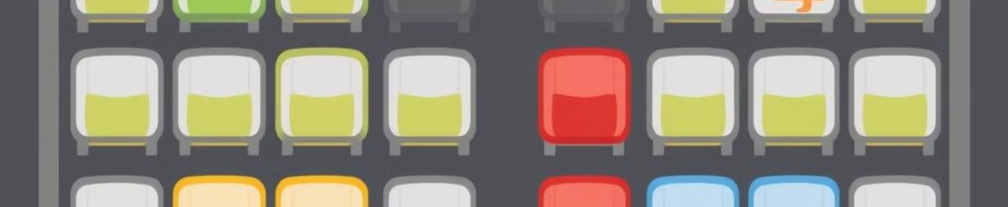
Seat Display
E
Empty Seat
B
Booked Seat
F
Female-Booked Seat
X
Seats Restricted for Males

Slide 9
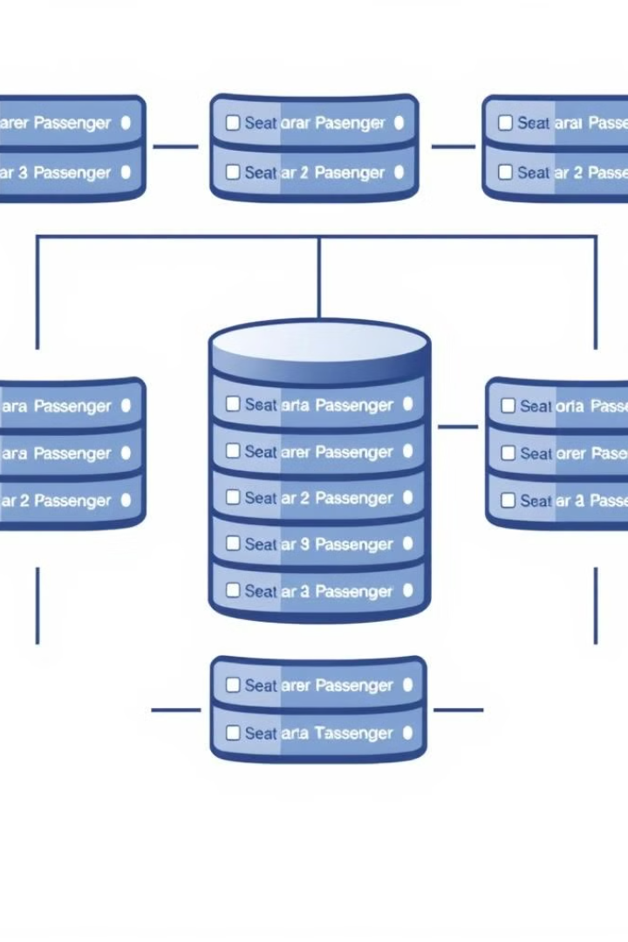
Data Management
1
Passenger Details
Passenger names and genders are stored in arrays.
2
Seat Availability
Seat availability for each bus is tracked separately.
3
Gender-Based Rules
The system enforces seating rules based on passenger gender.
4
Efficient Handling
Loops and conditions manage booking, cancellation, and display processes.

Slide 10

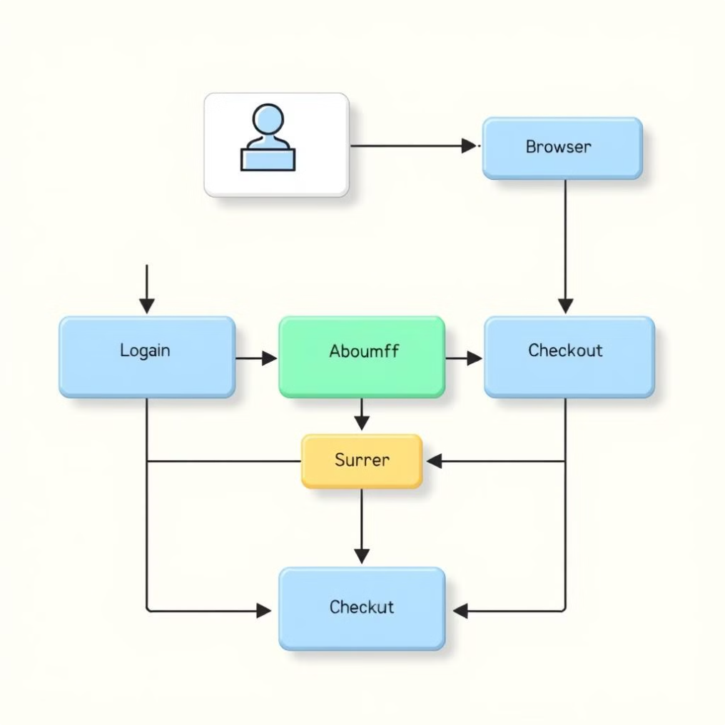
System Flow
User Navigation
The program handles different user inputs and loops through the main menu until the user exits.
Input Validation
All user inputs, such as seat numbers, bus selection, and gender, are validated to ensure proper system operation.
Consistent Feedback
The system continuously displays meaningful prompts and feedback to guide users through their actions.
Comprehensive Solution
This Bus Reservation Management System provides an efficient and user-friendly solution for managing bus bookings and seating arrangements.

